Slide 1


Project Presentation (KCS 753) (Adaptive Online Platform For Enhanced Teaching and Learning)
KIET Group of Institutions, Ghaziabad
(An ISO – 9001: 2008 Certified & ‘A+’ Grade accredited Institution by NAAC)
Computer Science
Guide Name: Dr. Gaurav Dubey
Project Members Name with Roll Number & Section
1. Amod Katiyar (2000290120022) (Sec-A)
2. Himanshu Kumar (2000290120076) (Sec-B)
3. Aniket Bhardwaj (2000290120024) (Sec-A)

Slide 2
Problem Statement :-
Despite the fact that there are many options and that everything is so diverse, students find it difficult to learn. Nothing can ever be found on a single platform. We intend to resolve this issue
The numerous possibilities that a student faces when deciding on a Specific domain to work in, the numerous questions that arise in his mind as to whether this is suitable for me or not, whether it will help me land a job in an MNC or not.
How to practice and revise concepts to achieve the best results. Instead of spending hours researching which courses to take and which channels to follow on the internet, our platform has already done all of the legwork for you, saving you a lot of time. Furthermore, all of that content will be available in a single location.

Slide 3
Objectives :-
Our goal is to address the issues that students face on a daily basis, which may not seem significant at first but can be extremely harmful in the long run. Choosing a domain that does not excite you or is not of your interest and devoting time to it will result in time wasted
It is pointless to learn essentially extinct technologies that have been replaced by newer and more advanced technologies. knowing the current industry trend and selecting a domain based on it will prove fruitful to you.
Learning the concepts in the prescribed order ensures that no important topics are overlooked and that the student has a thorough understanding of each and every topic.

Slide 4
Technology Used :-
The platform's development has been divided into two parts: frontend and backend. The frontend will be built with HTML and CSS, where HTML will provide the basic framework for the website and CSS will be used for styling.
The backend will be built with React, Express, and Node JS, as well as JavaScript. React and JavaScript will provide functionality to the website, as well as the necessary post and get requests. MongoDB will be used to create a database that will store the students' information as well as their current progress.
Machine learning techniques are used in the industry to implement real-time language usage. the rate at which the particular language is growing and the language's future trends. The domains that are currently required in the industry, as well as the average salary trends for jobs in the respective domain.

Slide 5
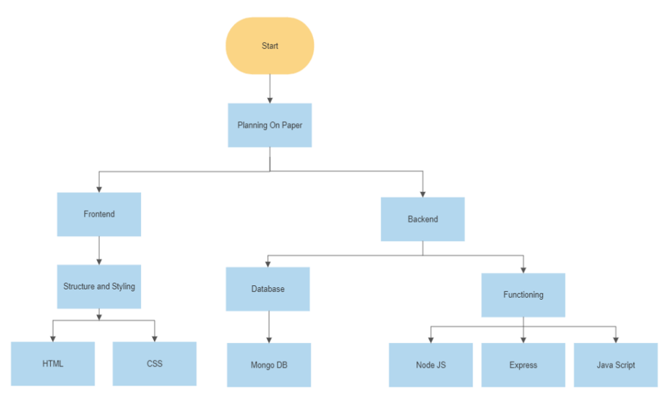
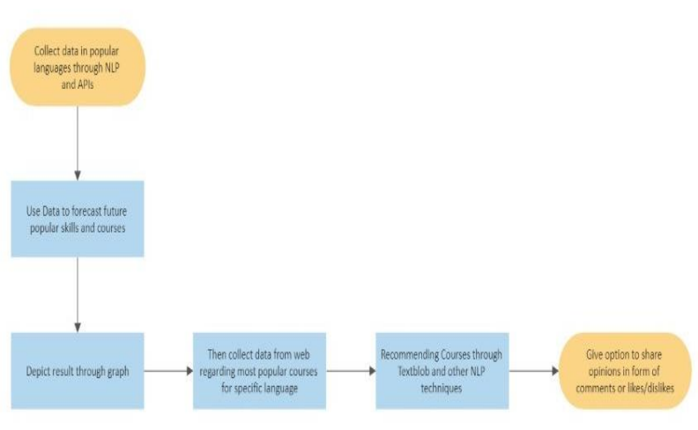
Work flow Diagram :-

Slide 6
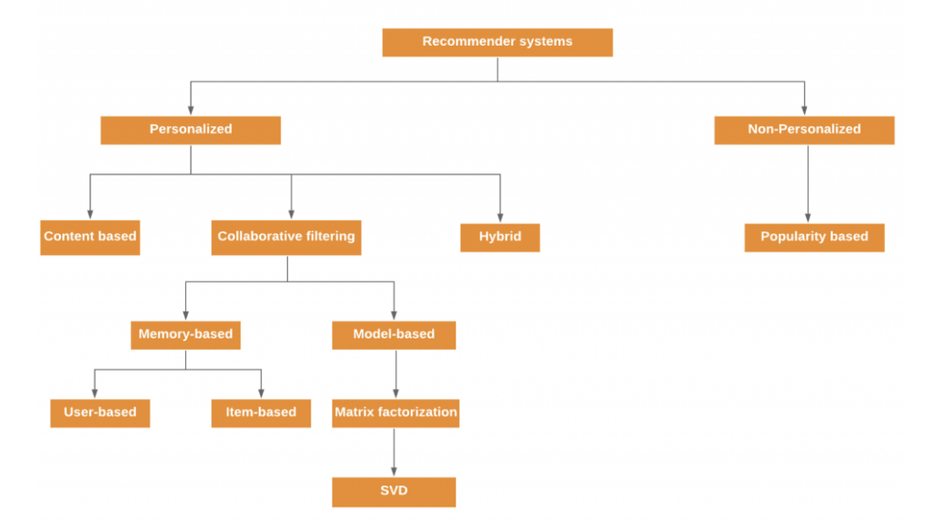
Workflow Diagram :-

Slide 7
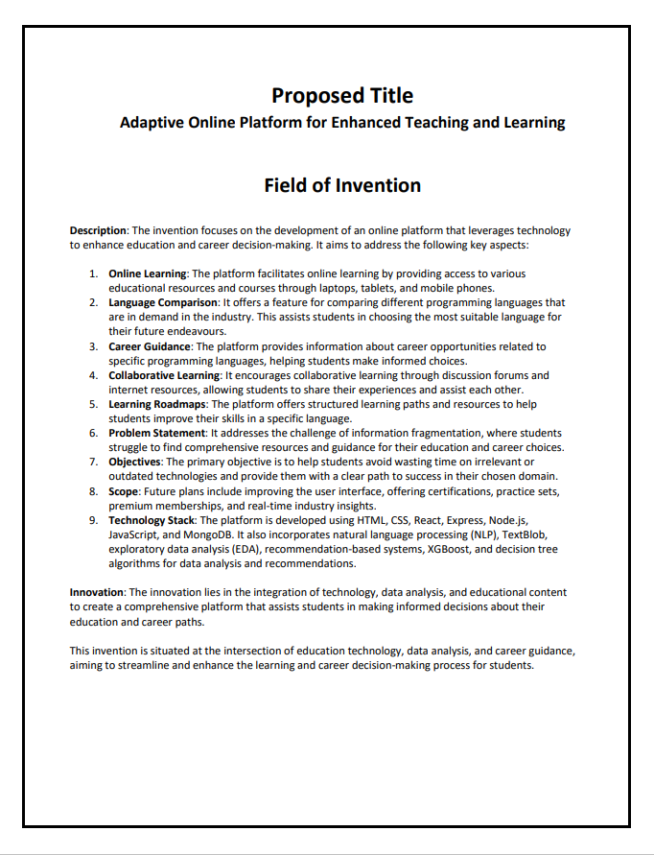
Patent Status
Published

Slide 8
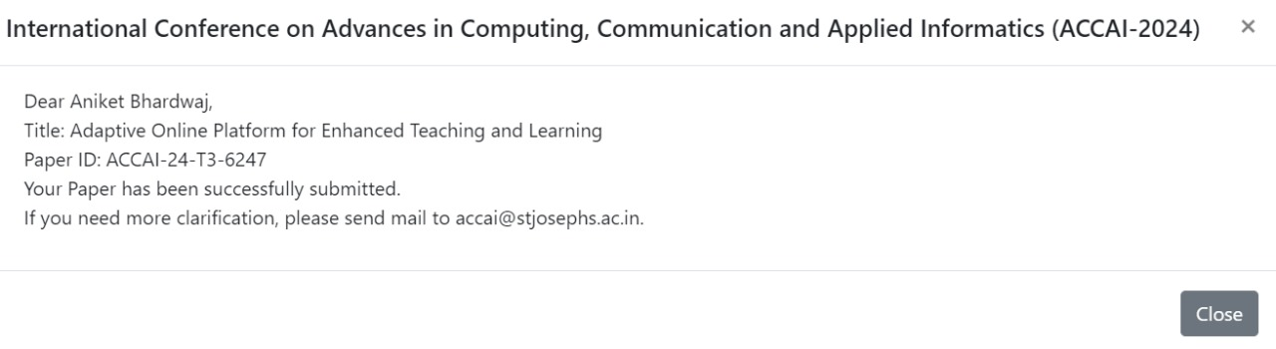
Research Paper Status
Completed Research Paper and sent for publication

Slide 9
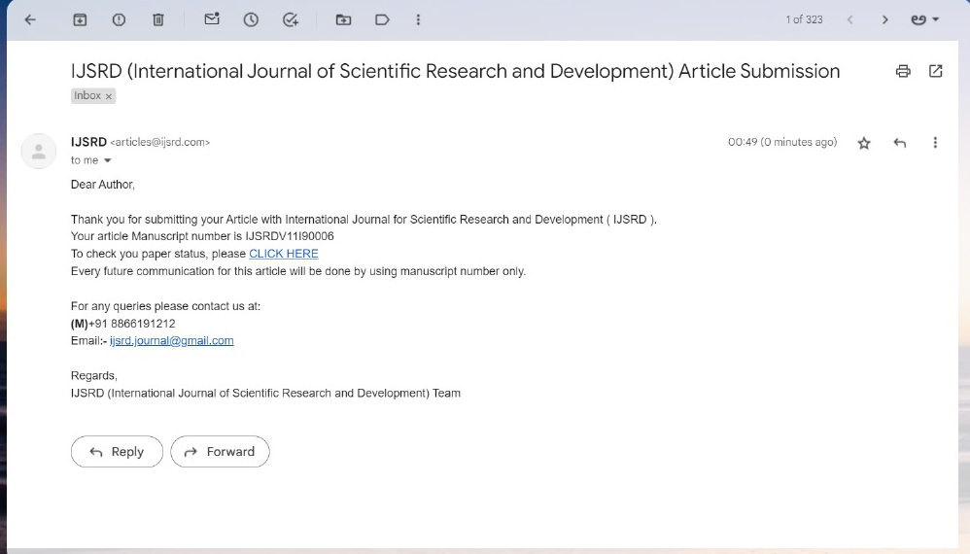
Research Paper Status :-
Completed Research Paper and sent for publication

Slide 10
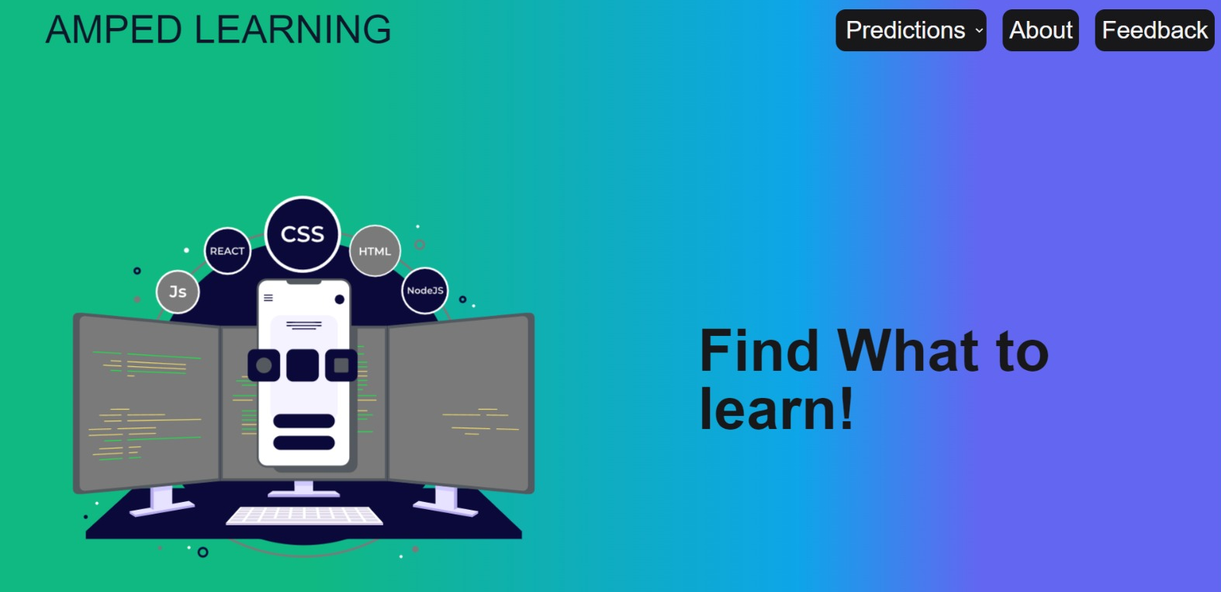
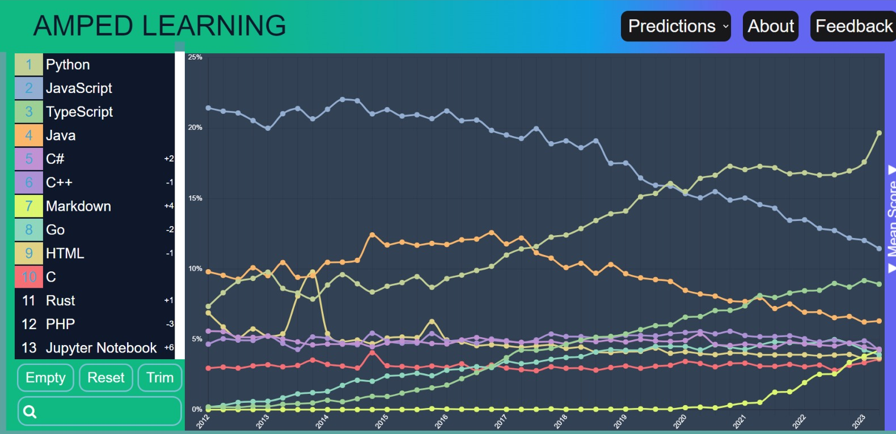
Project Status :-

Slide 11
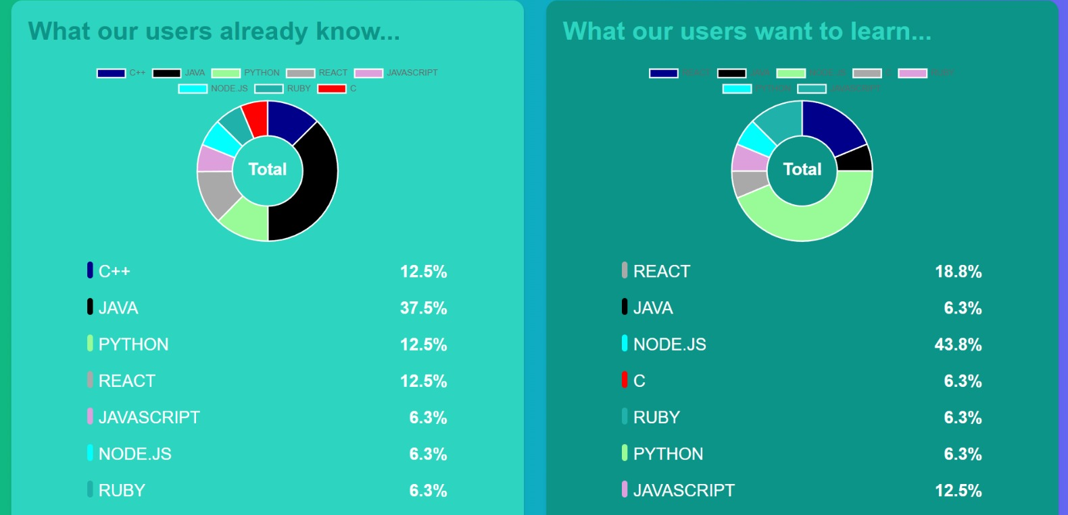
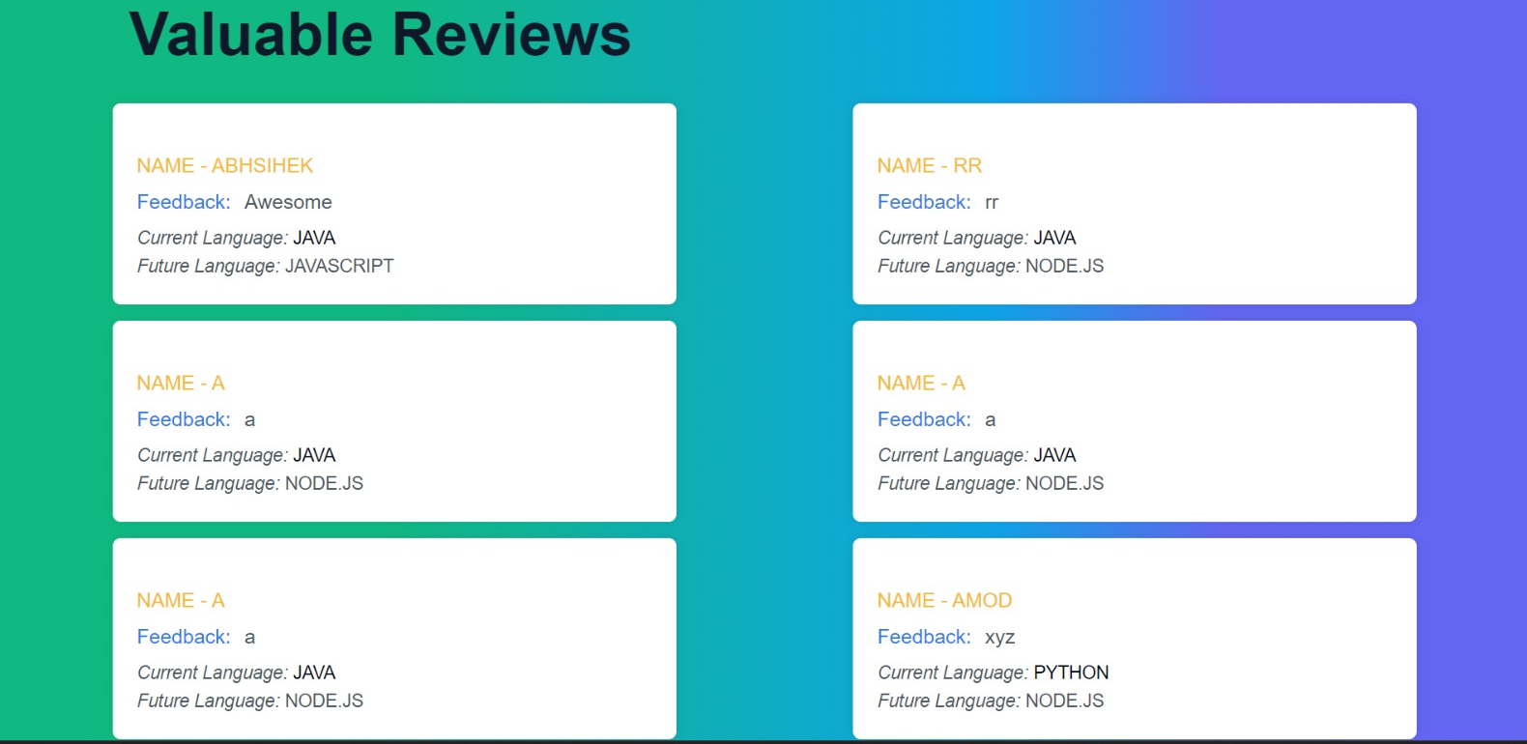
Project Status :-

Slide 12
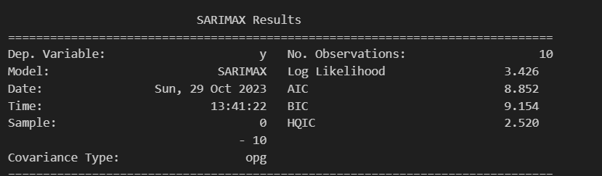

Testing Report for Prediction Algorithm :-
Log Likelihood: A measure of how well a statistical model describes the observed data.
AIC (Akaike Information Criterion): A metric that balances model fit and complexity; lower values indicate better models.
BIC (Bayesian Information Criterion): Similar to AIC but penalizes model complexity
HQIC (Hannan-Quinn Information Criterion): Another model selection criterion, often a compromise between AIC and BIC.
Ljung-Box Test: A statistical test for the absence of serial correlation in time series data.
Jarque-Bera Test: A test for the normality of data based on skewness and kurtosis.

Slide 13
References :-
[1] A review and analysis of technologies for developing web applications, BY-SOLOMON ANTONY
[2] Web Application Development -a study on UML Web Application Extension, Andreas Oskarsson, Martin Kling, Tobias Norberg
[3] Research on HTML5 in Web Development, Ch Rajesh, K S V Krishna Srikanth
[4] www.stackoverflow.com

